Slide 1
EMBEDDED SYSTEMS
By:-
M S Raj Ariyan(122EE0591)

Slide 2
Objective:-
Professors usually face problem when the previous class is not over in time and they have to wait outside the classroom. Develop a system which can connect the serial communication line of the classroom to the chambers of the professors one at a time as per the class routine. And send signal to the chamber of professor having the next class when the present class is over.

Slide 3
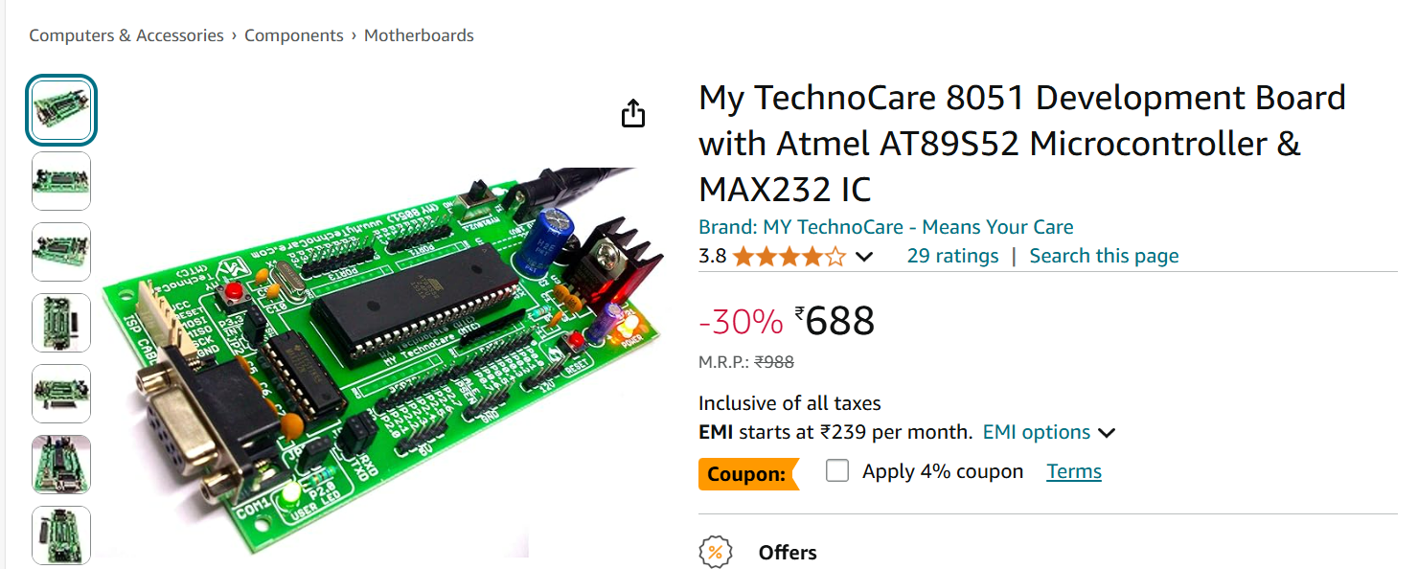
Components used:-

Slide 4
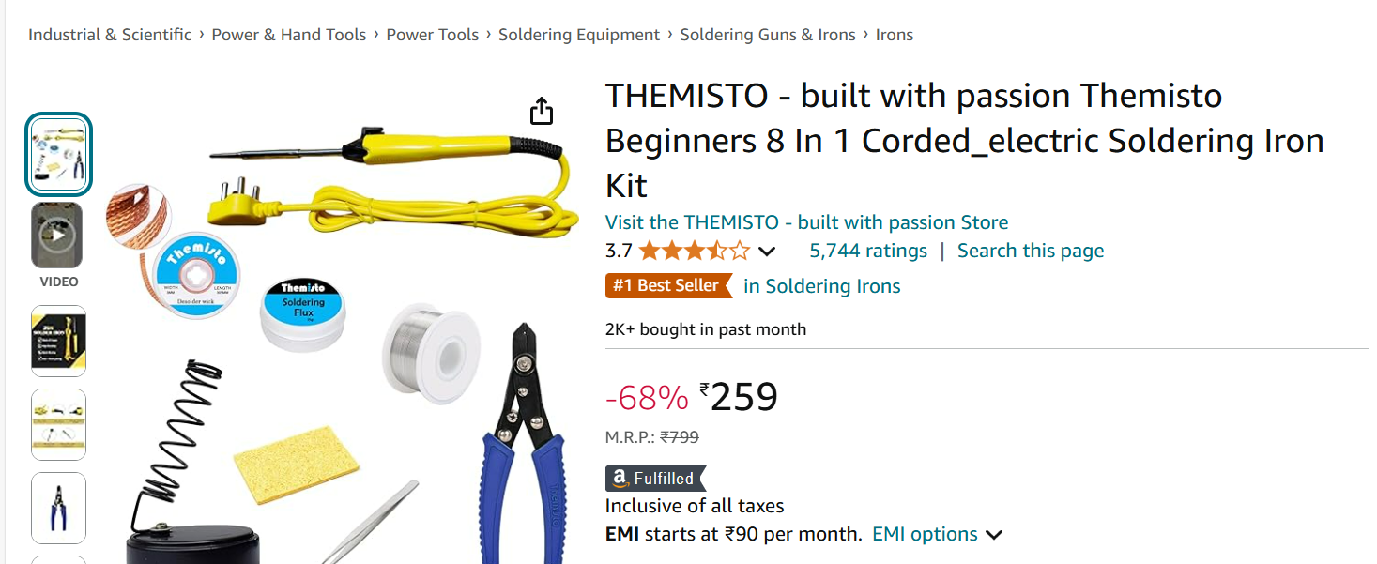
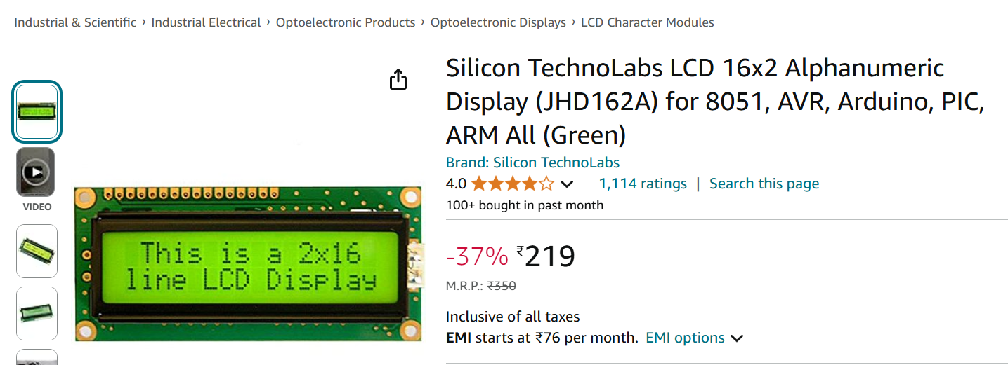

Slide 5
Other components:-
Resistor-120 ohms-1no.
Resistor-220ohms-5no.
RED-LED-3no.
GREEN-LED-3no.
Potentiometer-2k ohms-1no.
Switch-1no.
Connecting wires-As per req.(Male- Male, Male-Female)

Slide 6
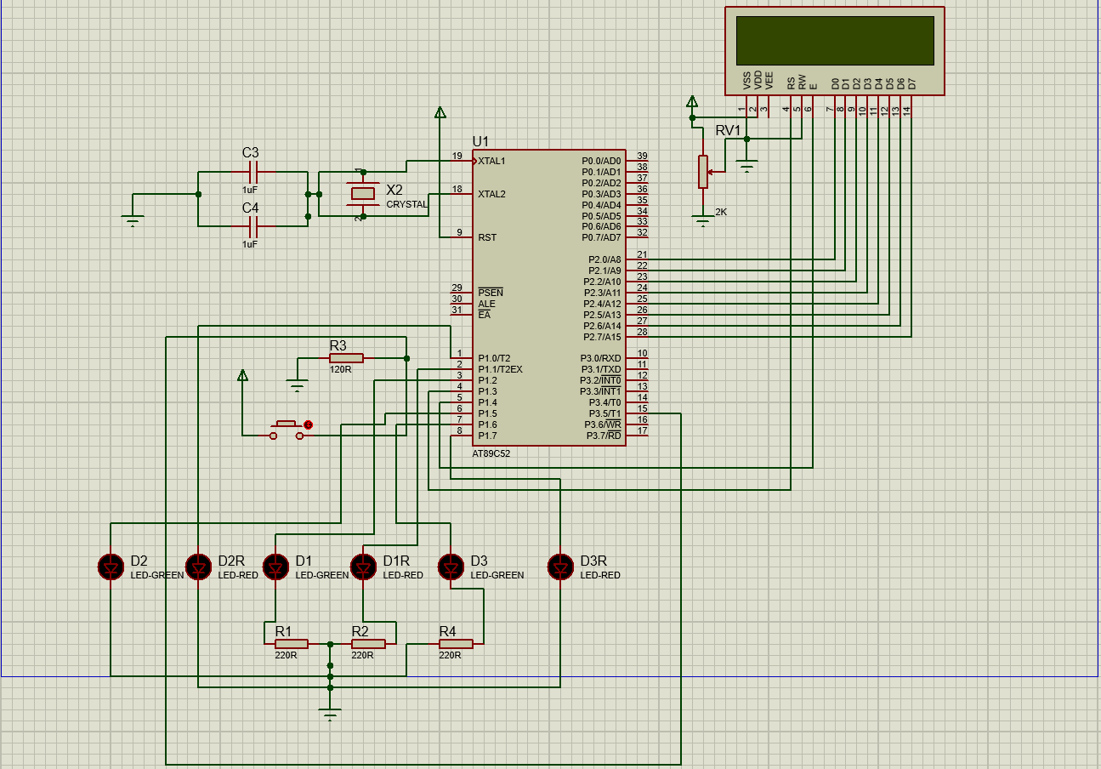
Circuit Diagram:-

Slide 7
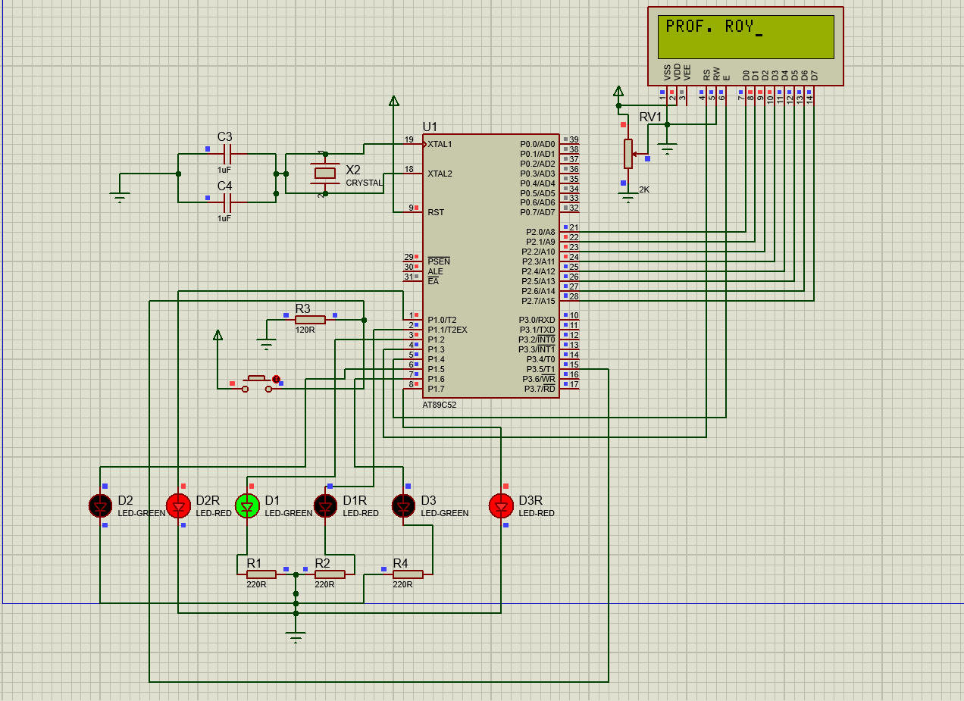
Schematic while simulation:-

Slide 8
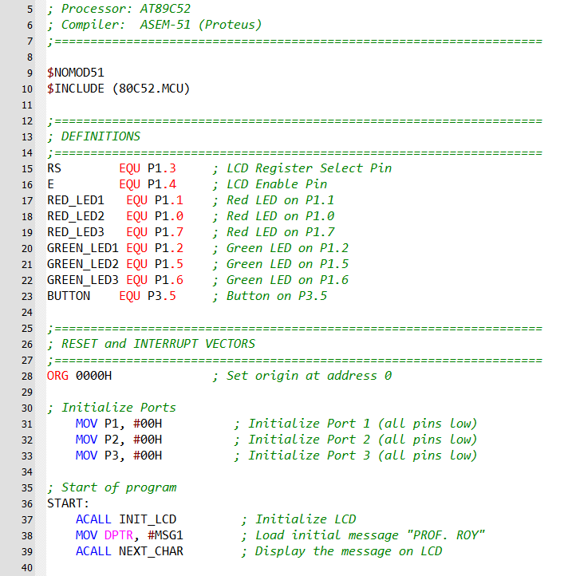
Code with comments:-
Start of program:-

Slide 9
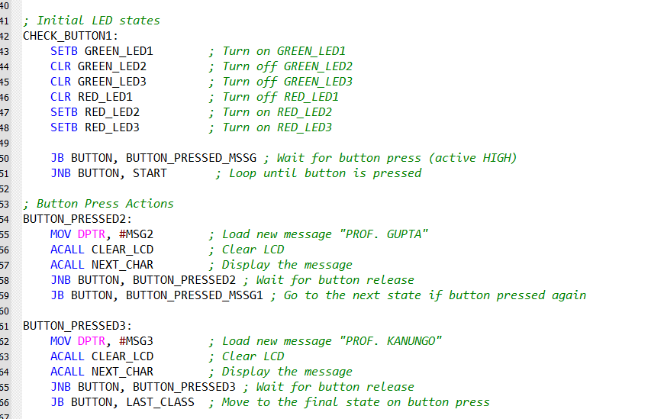
Initialisation Of LEDs:

Slide 10
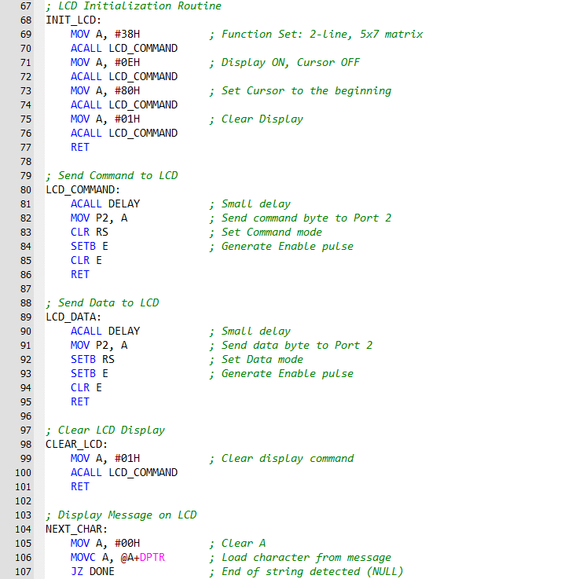
LCD initialization:

Slide 11
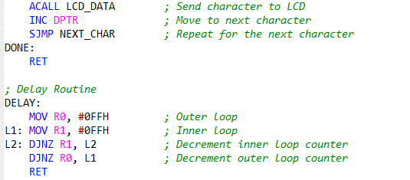
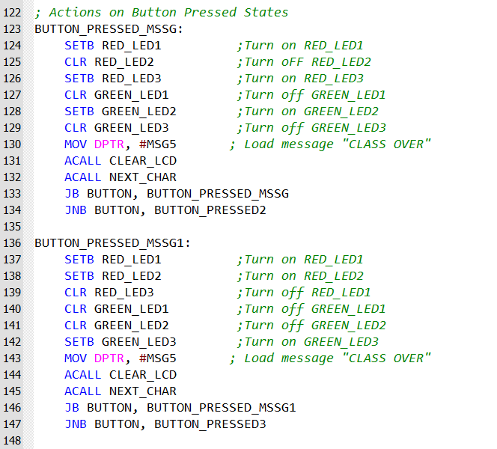
.
Action onButton Pressed :

Slide 12
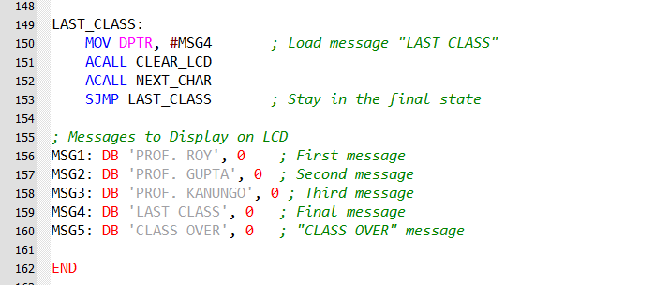
Messages to Display on LCD:

Slide 13
Test Results:-
SWITCH STATUS | LED1 | LED2 | LED3 | CLASS NUMBER | LCD DISPLAY
OPEN | GREEN | RED | RED | ONE | PROF. ROY
CLOSED | RED | GREEN | RED | TWO | CLASS OVER
OPEN | RED | GREEN | RED | TWO | PROF. GUPTA
CLOSED | RED | RED | GREEN | THREE | CLASS OVER
OPEN | RED | RED | GREEN | THREE | PROF. KANUNGO
CLOSED | RED | RED | RED | --------- | LAST CLASS OVER
---------- | ---------- | ---------- | ---------- | ---------- | ----------

Slide 14
Conclusion:-
The development of the system to manage serial communication between the classroom and professors' chambers based on the class routine, utilizing the 8051 microcontroller, is a significant step toward automating academic processes.
The system's capability to automatically notify the next professor after the conclusion of the current class enhances operational efficiency and reduces manual intervention. The use of the 8051 microcontroller ensures reliability, simplicity, and cost-effectiveness, making the solution feasible for educational institutions with similar requirements.

Slide 15
Key outcomes of the project include: Automated Scheduling: Seamlessly connects to the professor scheduled for the next class, ensuring smooth transitions . Effective Communication: Facilitates direct serial communication, improving the overall flow of information.
This project exemplifies the seamless integration of automation and technology in academia, paving the way for smarter, more efficient communication systems in educational institutions.
---------------------------------------THE END-------------------------------------------

